Slide 1

Narayana
Degala Sri Harsha
Punniya Dharshan

Slide 2
Identify patient population
We imported the data into my sql and queried on the selected diagnosis and procedural codes.
The medical center might want to maintain precision in the medical conditions. If the condition is heart block, it can be left artery block or right artery block or any other reason. The medical center would want to maintain one code for each. For example 4260 represents Atriovent block complete , 4262 represents Left bb hemiblock

Slide 3
Identify patient population
patient can visit the hospital with multiple health issues. We might want to maintain a single identification for each issue rather than multiple records.
Rather than putting all codes in a single cell.
In medical perspective we can maintain one as principal diagnosis and all other secondary diagnoses. The diagnoses can be shifted during processing. This is the first normalization for the design. It will be easier to analyze the data as well.

Slide 4
Identify patient population
First we create temporary table with the defined diagnosis codes.
insert into sid_test
(select * from sid where dx1 in ('4260', '4262' , '4263' , '4264' ,'4265' , '4266' , '4267' , '4268' , '4269' , '42789' ) )
union distinct
(select * from sid where dx2 in ('4260', '4262' , '4263' , '4264' ,'4265' , '4266' , '4267' , '4268' , '4269' , '42789' ) )
union distinct

Slide 5
Identify patient population
Similarly on the procedural code
Create table sid_implant
(select * from sid_test where pr1 in (‘3782’,’3783’,’3781’) )
union distinct
(select * from sid_test where pr2 in (‘3782’,’3783’,’3781’) )

Slide 6
Identify patient population
When the patient visits the hospital, the days difference between the joining date and start date is calculated and stored as the DaysToEvent.
For faster response, date is converted into numeric form.

Slide 7
Identify patient population
We stored the resources with pacemaker implantation ie with the procedural codes ‘3782’,’3783’,’3781’ in a table
sid_implant1
create table sedd_total_diag1 (
select VISITlink , DaysToEvent , FEMALE , key1 , Race, dx1,dx2,dx3,dx4,dx5,dx6,dx7,dx8,dx9,dx10 from sedd_2009)
union
(select VISITlink , DaysToEvent , FEMALE , key1 , Race ,dx1,dx2,dx3,dx4,dx5,dx6,dx7,dx8,dx9,dx10 from sedd_2010 ) ;
create view Vsedd as
select a.visitlink , max(a.DaysToEvent) as days
from sedd_total_diag1 a , sid_implant1 b
where a.visitlink = b.visitlink
and a.DaysToEvent < b.DaysToEvent
group by 1 ;

Slide 8
Identify patient population
The sql for the population of the two criterion
select female , race , count(*)
from sid_implant a ,
(SELECT a.VISITlink as link , (a.DaysToEvent - b.days) as days
FROM
sid_implant a , Vsedd b
where a.VISITlink = b.VISITlink ) b
where a.visitlink = b.link
and b.days < 365
group by 1,2

Slide 9
Identify patient population
We grouped diagnosis code with the gender
create table sedd_diag select a.dx1, a.female, count(*) from sedd_total_diag a, sid_implant1 b where a.VISITlink = b.VISITlink and a.DaysToEvent < b.DaysToEvent and a.dx1 is not null group by 1 ,2
Union
DX2
Union
D3
Select DX, sum(count(*)) from sedd_diag group by 1 order by 2

Slide 10
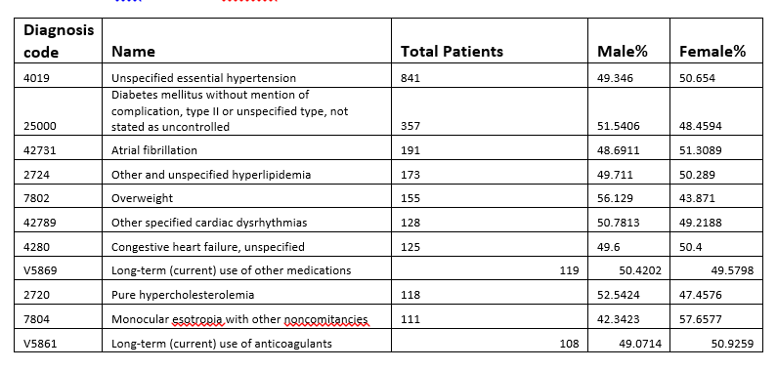
Identify patient population

Slide 11
Identify patient population
By comparing the diagnosis codes there are none in top 15 that are gender biased. However there are few diagnosis codes that are much lower in male than in female. Namely 5990,2449,7840. There are chances of being overlooked in these cases.
5990: Urinary tract infection, site not specified it has only 31% male
2449: Unspecified acquired hypothyroidism has only 28% male
7840:Headache has 38% male

Slide 12
Identify patient population
To improve the query performance we added index. We added index to the tables total_diag1 and sid_implant1
By writing complicated queries the run time is being increased and data is squeued, we created views(Vsedd) on the tables and limited the columns.
The table total_diag1 is a combination of sedd_2009 and sedd_2010. If we load all data the query takes infinite time, we only joined few fields and loaded.
We used union to collect data of all the 10 diagnosis codes. We eliminated he junk data by using the not null function.
The query performance was around 5000 seconds. It reduced to around 2000 seconds by adding indexes. PFB the screenshots.
The query performance was around 5000 seconds. It reduced to around 2000 seconds by adding indexes. PFB the screenshots.

Slide 13
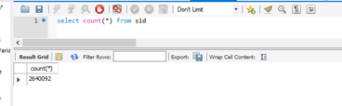
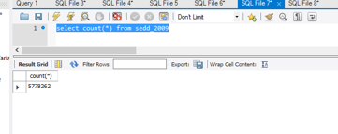
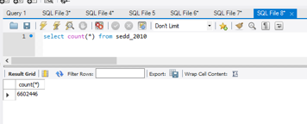
Identify patient population

Slide 14

Questions
?

Slide 15
THANK YOU

